Slide 1
IE613 Course Project Survey on Cascading Bandits
Team Members
DIVYANSH AHUJA – 17D070038
SUMRIT GUPTA – 170040044
NAMAN NARANG – 17D070012

Slide 2
Introduction
The aim of this survey is to study and implement various existing algorithms on cascading bandits and analyze them.
In this work, we study cascading bandits, an online learning variant of the cascade model where the goal is to recommend K most attractive items from a large set of L candidate items.
The algorithms studied are C³-UCB(for contextual cascading bandits), Thompson sampling, Cascade-UCB, Cascade-KLUCB,

Slide 3
Contextual Combinatorial Cascading Bandits

Slide 4
Contextual Combinatorial Cascading Bandits
The paper proposed the contextual combinatorial cascading bandits, a combinatorial online learning game, where at each time step a learning agent is given a set of contextual information, then selects a list of items, and observes stochastic outcomes of a prefix in the selected items by some stopping criterion.
We design a UCB-type algorithm, C^3-UCB, for this problem. This work generalizes existing studies in several directions, including contextual information, position discounts, and a more general cascading bandit model. Experiments on synthetic demonstrate the advantage of involving contextual information and position discounts.
Reference:- Shuai Li, Baoxiang Wang, Shengyu Zhang, Wei Chen ; Proceedings of The 33rd International Conference on Machine Learning, PMLR 48:1245-1253, 2016

Slide 5
Problem Setting
Suppose we have a finite set E = {1, ..., L} of L ground items, also referred to as base arms. Let Π^{k} = {(a¹, ..., a^{k}) :a¹, ..., a^{k} ∈ E, a^{i} ≠ a^{j} for any i ≠ j} be the set of all k-tuples of distinct items from E; we call each of such tuples an action of length k.
Let Π^{≤K} = ∪ K k=1Πk deno te the set of all actions with length at most K, and let S ⊆ Π≤K be the set of feasible actions with length at most K
At time t, feature vectors x t,a ∈ R d×1 with kx t,a k 2 ≤ 1 for every base arm a ∈ E are revealed to the learning agent.
Then the learning agent recommends a feasible action A t = (at1 , ..., a t |A t | ) ∈ S to the user. In the cascading feedback models, the user checks from the first item of recommended action and stops at the O t -th item under some stopping criterion.

Slide 6
Problem Setting
We assume the expected reward of action A is a function f (A, w) of expected weights w = (w(a)) satisfies the following two assumptions.
Monotonicity
Lipschitz continuity
We assume that each wt(a) is a random variable with R-sub-Gaussian
tail.

Slide 7
About the algorithm
The C^3-UCB algorithm comes up with a upper confidence bound on the mean of arms using the previous data and present context and returns the arms with K-highest UCBs.
The reference paper also shows that the regret of the algorithm is bounded by O(√T. log(T)).

Slide 8
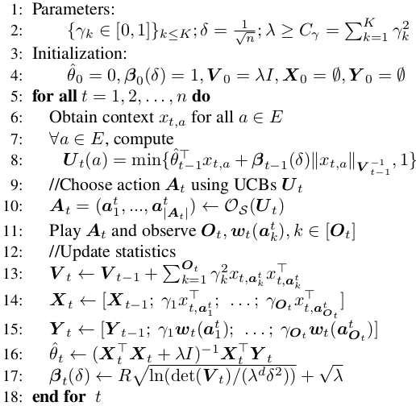
C³-UCB Algorithm
Here O_{s} (U_{t}) on line 10 is the
oracle function , which in our
case returns the K arms
with highest UCBs.
And O(t) is the feedback to
the learner and can be observed
in two ways disscussed
in next slides.

Slide 9

C³-UCB Algorithm
Disjunctive Objective - In the problem of cascading recommendation, when recommended with an ordered list of items At = (at1 , ..., at|At| ), the user checks the list in that order. The checking process stops if the user selects one item or has checked all items without selecting anyone. The weight of each base arm a at time t, wt(a), is a {0, 1} value indicating whether the user has selected item a or not. Then the random variable O(t) satisfies

Slide 10

C³-UCB Algorithm
Conjunctive Objective - The Bernoulli random variable wt(a) ∈ {0, 1} indicates the weight of item a at time t satisfying. The learning agent observes the first position k in the given action At = (at1 , . . . , at|At|) with wt(atk) = 0.At the end of time step t, the learning agent observes
Ot, w_{t} (a_{t}^{k} ), ∀k ≤ Ot and receives a reward rt :
Also in disjunctive objective, the agent recieves a reward 𝛄_{k} instead of 1- 𝛄_{k}

Slide 11
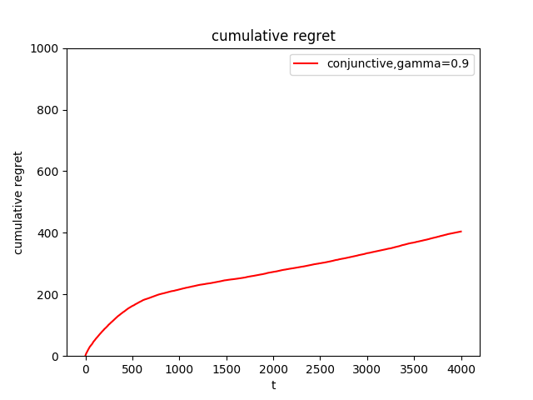
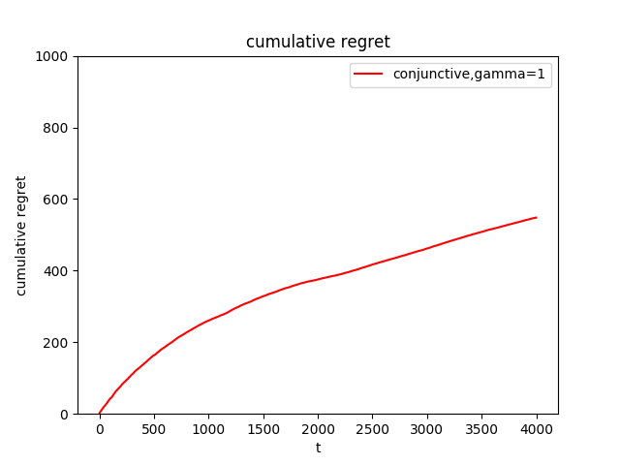
Simulation Results
The following results are obtained for Synthetic Data Set, L = 200, K = 4, d = 20. Ө* and context( X_{t,a}) are generated randomly, and 𝛄_{k} =𝛄^{k} for some constant 𝛄

Slide 12
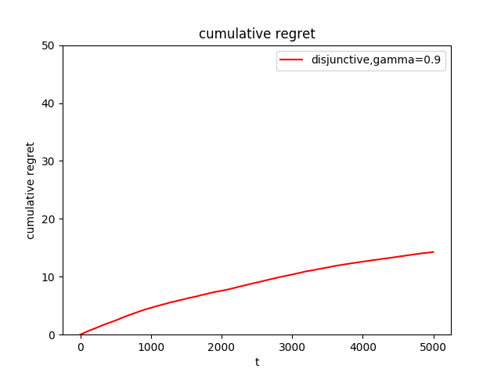
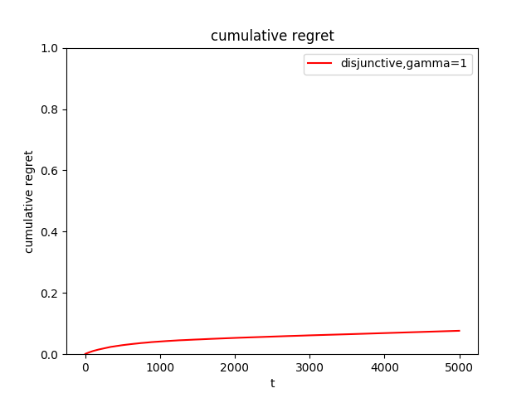
Simulation Results

Slide 13
Simulation Results
From the above obtained plots we can see that in conjunctive objective the regret at time T increases on increasing gamma, and in disjunctive objective the regret at time T decreases on increasing gamma.
Our algorithm outperforms CombCascade algorithm because they do not make use of the contextual information.

Slide 14
Thompson Sampling for Cascading Bandits

Slide 15
Thompson Sampling for Cascading Bandits
We analyze TS-Cascade, a Thompson sampling algorithm for the cascading bandit problem. In TS-Cascade, Bayesian estimates of the click probability are constructed using a univariate Gaussian; this leads to a more efficient exploration procedure vis-à-vis existing UCB-based approaches. We also incorporate the empirical variance of each item's click probability into the Bayesian updates. Empirical experiments demonstrate superiority of TS-Cascade compared to existing UCB-based procedures in terms of the expected cumulative regret and the time complexity.
Reference - Thompson Sampling for Cascading Bandits Wang Chi Cheung, Vincent Y. F. Tan, Zixin Zhong

Slide 16
Problem Setting
The problem setting is similar to that in C³-UCB, except there is no context provided.
We have L ∈ N ground items, denoted as [L] := {1, . . . , L}. Each item i ∈ [L] is associated with a weight w(i) ∈ [0, 1], signifying the item’s click probability. At each time step t ∈ [T ], the agent selects a list of K ≤ L items S t := (i t 1 , . . . , i tK ) ∈ π K (L) to the user, where π K (L) denotes the set of all K-permutations of [L]. The user examines the items from i t 1 to i tK by examining each item one at a time until possibly all items are examined. For 1 ≤ k ≤ K, W t (i tk ) ∼ Bern (w(i tk )) are i.i.d. and W t (i tk ) = 1 iff user clicks on i tk at time t.

Slide 17
About the algorithm
In our algorithm, we approximate the true weight w(i) of each item i by an statistic θ t (i) at each time step t. This statistic is known as the Thompson sample. To do so, first, we sample a one-dimensional standard Gaussian Z t ∼ N (0, 1), define the empirical variance ν̂ t (i) = μ̂ t (i)(1 − μ̂ t (i)) of the previously observed arms, and calculate θ t (i). Secondly, we select S t = (i t 1 , i t 2 , . . . , i tK ) such that θ t (i t 1 ) ≥ θ t (i t 2 ) ≥· · · ≥ θ t (i tK ) ≥ max_{j∉St}θ t (j). Finally, we update the parameters for each observed item i in a standard manner by applying Bayes rule on the mean of the Gaussian (with conjugate prior being another Gaussian).

Slide 18
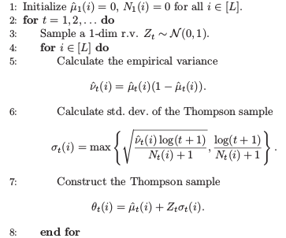
Cascade TS algorithm

Slide 19
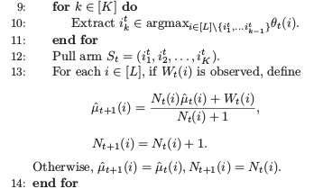
Cascade TS algorithm

Slide 20
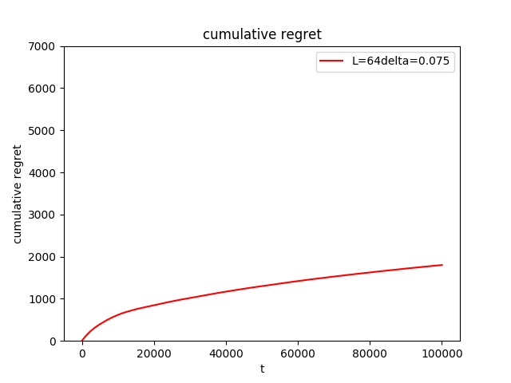
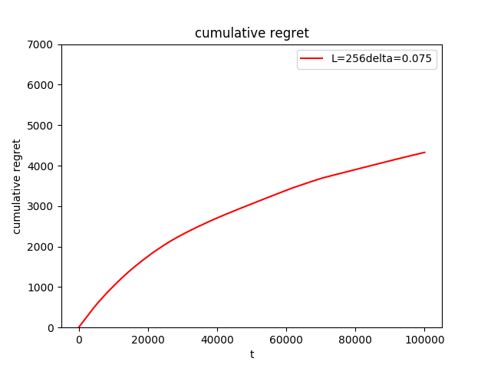
Simulation Results
Reg(T) of TS-Cascade with L ∈ {64, 256} (resp. left and right), K = 2 and ∆ = 0.075. Each line indicates the average Reg(T) (over 20 runs)

Slide 21
Simulations
L | K | Delta | Regret
16 | 2 | 0.15 | 350.11
16 | 4 | 0.15 | 315.6
16 | 8 | 0.15 | 129.88
32 | 2 | 0.075 | 754.36
32 | 4 | 0.075 | 629.34
32 | 8 | 0.075 | 381.3
32 | 2 | 0.075 | 1168.48
32 | 4 | 0.075 | 906.581
32 | 8 | 0.075 | 569.358
64 | 2 | 0.075 | 1723.59
64 | 4 | 0.075 | 1796.254
64 | 8 | 0.075 | 1058.98
128 | 2 | 0.075 | 2569.59
128 | 4 | 0.075 | 2698.84
128 | 8 | 0.075 | 1867.54
256 | 2 | 0.075 | 4589.65
256 | 4 | 0.075 | 4549.72
256 | 8 | 0.075 | 3574.57
The regrets obtained
from TS cascade
algorithmfor different
parameter values.

Slide 22
Simulation results
From the above plots and tabulated data we can see that on increasing K, the regret decreases and on increasing L, the regret increases, and on on increasing delta, the regret increases. Also this makes sense because on decreasing delta we reduce the difference between optimal and suboptimal arms and hence it becomes difficult for the algorithm to distinguish between them.

Slide 23
Abstract
COST AWARE CASCADING BANDIT
We propose a cost-aware cascading
bandits model by considering the random cost of pulling arms.
In each step, the learning agent chooses an ordered list of items and
examines them sequentially, until certain stopping condition is satisfied.
Our objective is then to maximize the expected net reward in each step, i.e., the reward obtained in each step minus the total cost incurred
in examining the items, by deciding the ordered
list of items, as well as when to stop examination.
Reference - Cost-aware Cascading Bandits
Ruida Zhou, Chao Gan, Cong Shen
Published in IJCAI 2018
DOI:10.24963/ijcai.2018/448

Slide 24
Introduction
In this paper, we introduce a new cost-aware cascading bandits (CCB) model. We consider a set of K items (arms) denoted as [K] = {1, 2, . . . , K}.
Each item i ∈ [K] has two possible states 0 and 1, which evolve according to an independent and identically distributed (i.i.d.) Bernoulli random variable.
The learning agent chooses an ordered list of items in each step and examines them sequentially until certain stopping condition is met.
The reward that the learning agent receives in a step equals one if one of the examined items in that step has state 1; Otherwise, it equals zero. We associate a random cost for examining each item.

Slide 25
Setting up the problem
In step t, the learning agent chooses an ordered list of arms
from [K] and pull the arms sequentially. Once an arm is
pulled, its state and the pulling cost are revealed instantly.
Denote the ordered list as I t := {I t (1), I t (2), . . . , I t (|I t |)},
where I t (i) is the ith arm to be pulled, and |I t | is the cardinal-
ity of I t .
Denote I ̃ t as the list of arms that have been actually
pulled in step t. The learning agent gets reward one if one of the arms that have been examined in step t has state 1; Otherwise, it equals zero.

Slide 26

Online Policy and Algorithm
The net reward structure in our setting is complex. One difficulty is that the
learner has to rank θ i /c i and compare it with threshold 1 for Exploitation.
We use an UCB-type indexing policy to rank the arms. The costs are assumed to be random but the learning agent has no knowledge of their distributions.
We use N i,t to track the number of steps that arm i has been pulled up to step i, and θ̂ i,t , ĉ i,t to denote the sample average of θ i and c i at step t, respectively.
The UCB padding term on the state and cost of arm i at step t is
where α is a positive constant no less than 1.5.
CC-UCB adopts the OFU principle to construct an upper bound of the ratio θi/ci .
we have to deal with two types of regret: the regret caused by pulling “bad” arms
(θ i < c i ); and that caused by pulling “good” arms in a wrong order.

Slide 27
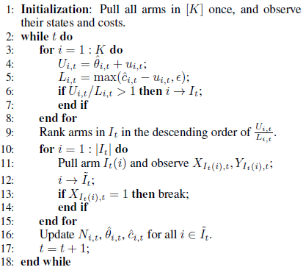
Psuedo Code for Cost-Aware Cascading Bandit

Slide 28
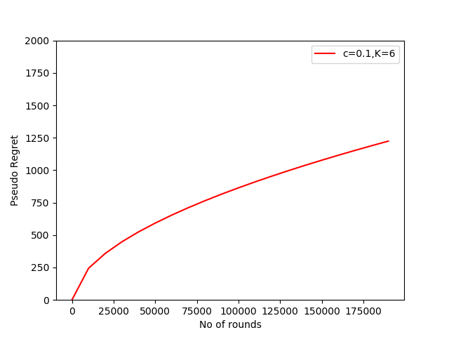
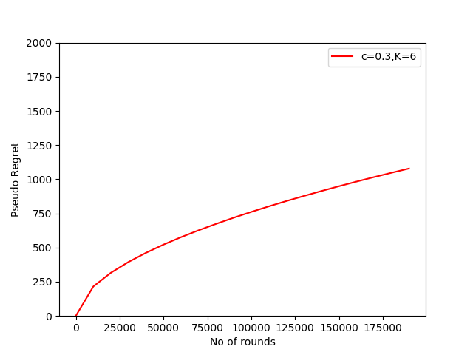
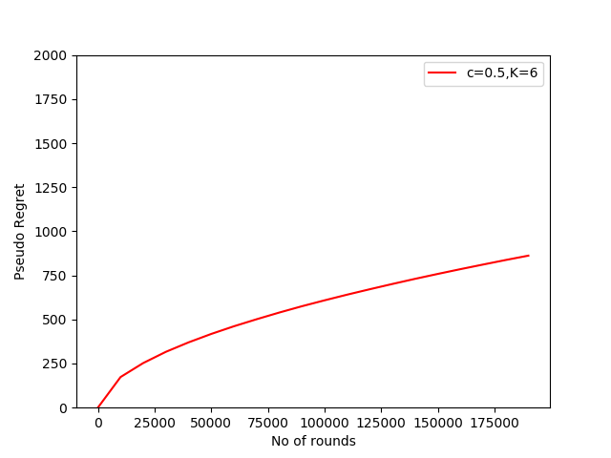
Simulation Results
The following results are obtained for a 6-arm bandit setting with θ = [0.8, 0.7, 0.6, 0.5, 0.4, 0.3] and the mean of the cost, c is varied .

Slide 29
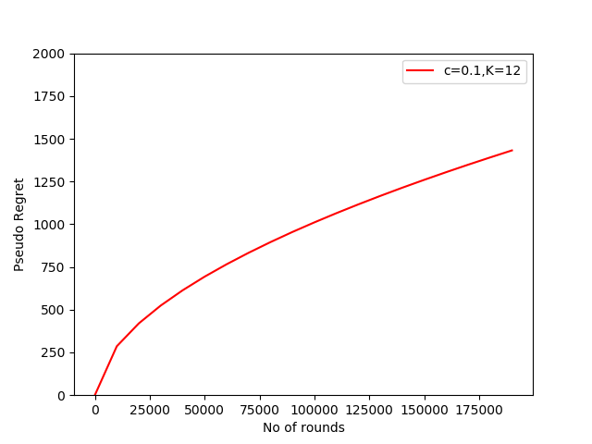

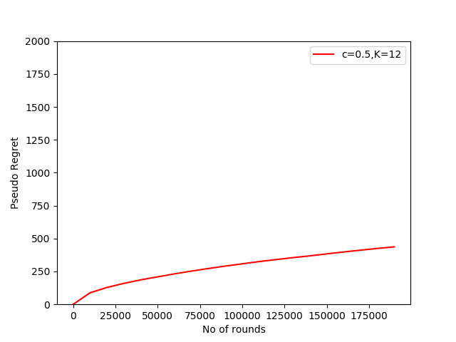
Simulation Results
The following results are obtained for a 12-arm bandit setting with θ = [0.5, 0.5, 0.5, 0.5, 0.5, 0.5, 0.3, 0.3, 0.3, 0.3, 0.3, 0.3] and the mean of the cost, c is varied .

Slide 30
Conclusions
We observe that the cumulative regret grows sub-linearly
in time, and monotonically increases as c increases, which
are consistent with our algorithm.
This indicates that the CC-UCB algorithm performs very well even when some of the assumptions (such as the i.i.d. evolution of arm states) we
used to derive the performance bounds do not hold.
The regret increases when the number of arms K doubles. Second, the
regret decreases when the number of arms in I ∗ (i.e., L) increases. Third, a prori knowledge of cost statistics always improve the regret.

Slide 31
Abstract
Combinatorial Cascading Bandits
We propose combinatorial cascading bandits, a class of partial monitoring problems where at each step a learning agent chooses a tuple of ground items subject to constraints and receives a reward if and only if the weights of all chosen items are one.
The weights of the items are binary, stochastic, and drawn independently
of each other. The agent observes the index of the first chosen item whose weight is zero.
This observation model arises in network routing, for instance, where the
learning agent may only observe the first link in the routing path which is down, and blocks the path.
Reference - Combinatorial Cascading Bandits in proceedings of NIPS 2015 by Branislav Kveton Zheng Wen Azin Ashkan Csaba Szepesvari

Slide 32
Introduction
In this work, we study a class of combinatorial optimization problems with a binary objective function that returns one if and only if the weights of all chosen items are one. The weights of the items are binary, stochastic, and drawn independently of each other.
Combinatorial cascading bandits are a novel framework for online learning of the aforementioned problems where the distribution over the weights of items is unknown.
Our goal is to maximize the expected cumulative reward of a learning agent in n steps. Our learning problem is challenging for two main reasons.
First, the reward function is non-linear in the weights of chosen items.
Second, we only observe the index of the first chosen item with a zero weight. This kind of feedback arises frequently in network routing, for instance, where the learning agent may only observe the first link in the routing path which is down, and blocks the path.

Slide 33


Setting up the problem
The problem is represented by a tuple B = (E,P, Θ), where E = {1,……,L} is a ground set of L items, P is a probability distribution over a unit hypercube {0,1}^E,
Set of all tuples of distinct items from E
Let (wt)^n at t =1 be an i.i.d. sequence of n weights drawn from P, where (wt) belongs to {0,1}^E. Solution is chosen based on past observations and binary reward is receivedThe reward is one if and only if the weights of all items in At are one. So the reward function is defined as
The feedback by Ot is the index of the first item in At whose weight is zero, and infinte if such an item does not exist.
is the instantaneous stochastic regret of the agent at time t
The optimal solution in hindsight of knowing P is
which is found by factorizing
the distribution P as product of Pe(w(e)) where Pe is a Bernoulli distribution with mean w~(e)

Slide 34
Combcascade algorithm
At time t, CombCascade operates in three stages.
First, it computes the upper confidence bounds (UCBs) Ut ∈ [0, 1]^E on the expected weights of all items in E.
where ˆws(e) is the average of s observed weights of item e, Tt(e) is the number of times that item e is observed in t steps, and c t,s = sqrt((1.5 log t)/s) is the radius of a confidence interval
After the UCBs are computed, CombCascade chooses the optimal solution with respect to these UCBs:
Finally, CombCascade observes Ot and updates its estimates of the expected weights based on the
weights of the observed items for all items at k such that k ≤Ot
CombCascade has two attractive properties -
First, the algorithm is computationally efficient, in the sense that
is the problem of maximizing a linear function on Θ. This problem can be solved efficiently for various feasible sets Θ, such as matroids, matchings and paths.
Second, CombCascade is sample efficient because the UCB of solution A, f(A,Ut), is a
product of the UCBs of all items in A, which are estimated separately. The regret of CombCascade
does not depend on | Θ | and is polynomial in all other quantities of interest.

Slide 35
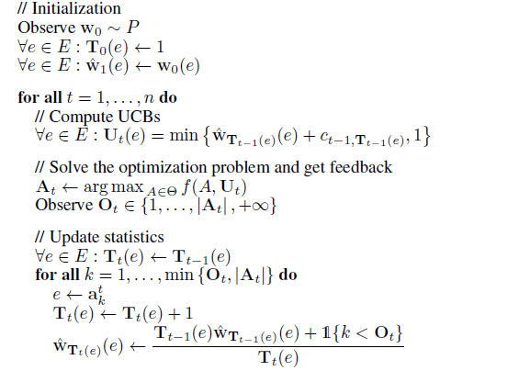
Psuedo Code for Combinatorial Cascading Bandit

Slide 36
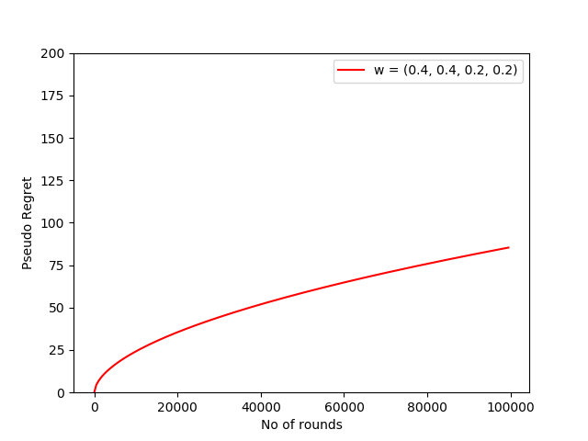


Simulation Results
The experiment was conducted with three different settings of w~. The settings of
w~ are reported in our plots. We assume that wt(e) are distributed independently, except for the last
plot where wt(3) = wt(4). So, in the third plot the modeling assumptions are violated.
The approximation is used that

Slide 37
CONCLUSIONS
The regret of CombCascade is bounded as R(n) ≦ 131*sqrt( KLnlogn/ f*) + π^2 L/3
CombCascade is a novel learning algorithm. CombUCB1 chooses solutions with the largest sum of the UCBs. CascadeUCB1 chooses K items out of L with the largest UCBs. CombCascade chooses solutions with the largest product of the UCBs.
The feedback is a non-linear function of the weights and the reward function is non-linear in unknown parameters.
The n-step regret of CombCascade is a concave function of time n for all studied K. This indicates that CombCascade solutions improve over time.

Slide 38
Cascade UCB1 And Cascade KL-UCB

Slide 39
Abstract
A search engine usually outputs a list of K web pages. The user examines this list, from the first web page to the last, and chooses the first attractive page. This model of user behavior is known as the cascade model. Here they propose cascading bandits, a learning variant of the cascade model where the objective is to identify K most attractive items.
They formulate our problem as a stochastic combinatorial partial monitoring problem. They propose two algorithms for solving it, CascadeUCB1 and CascadeKL-UCB. The algorithms perform surprisingly well even when our modeling assumptions are violated.

Slide 40
Introduction
In this paper, an online learning variant of the cascade model is proposed, which is referred to as cascading bandits. In this model, the learning agent does not know the attraction probabilities of items.
At time t, the agent recommends to the user a list of K items out of L items and then observes the index of the item that the user clicks. If the user clicks on an item, the agent receives a reward of one. The goal of the agent is to maximize its total reward, or equivalently to minimize its cumulative regret with respect to the list of K most attractive items.
Our learning problem can be viewed as a bandit problem where the reward of the agent is a part of its feedback.
The feedback is richer than the reward. Specifically, the agent knows that the items before the first attractive item are not attractive.

Slide 41
Setting up the Problem
The problem is represented by a tuple B = (E,P,K), where E = {1,……,L} is a ground set of L items, P is a probability distribution over a unit hypercube {0,1}^E, and K <= L is the number of recommended items.
Let (wt)^n at t =1 be an i.i.d. sequence of n weights drawn from P, where (wt) belongs to {0,1}^E and wt(e) is the preference of the user for item e at time t. That is, wt(e) = 1 if and only if item e attracts the user at time t. The learning agent interacts with our problem as follows. At time t, the agent recommends a list of K items At = (at1,……,atK) which belongs to ПK(E).
The list is computed from the observations of the agent up to time t. The user examines the list, from the first item at1 to the last atK, and clicks on the first attractive item. If the user is not attracted by any item, the user does not click on any item. Then time increases to t + 1.

Slide 42
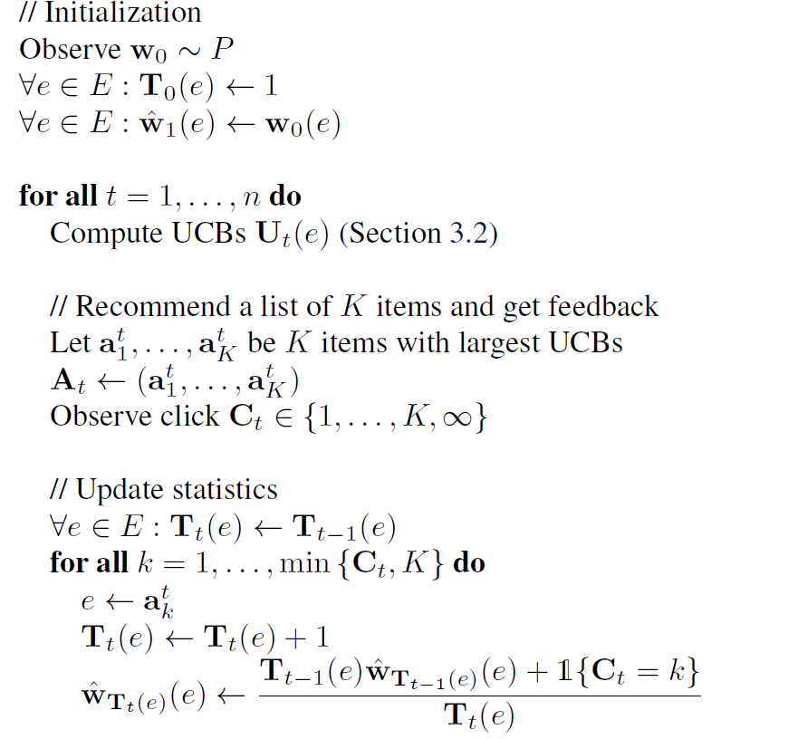
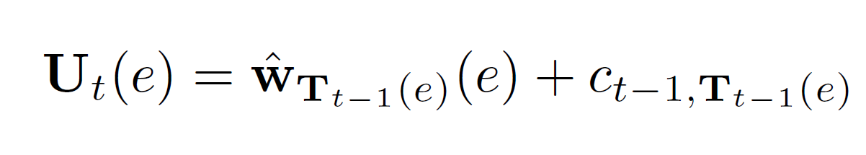
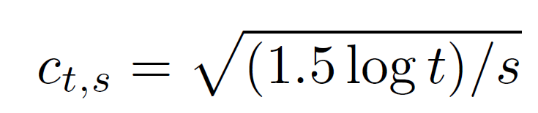
Psuedo Code for CascadeUCB1
Where
Where

Slide 43
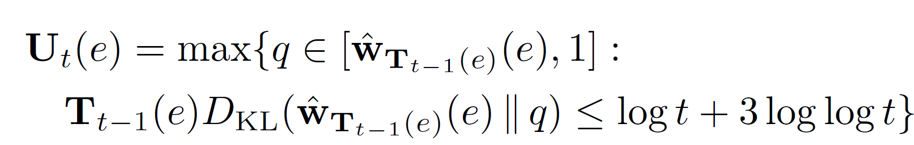
Psuedo Code for CascadeKL_UCB
Where

Slide 44
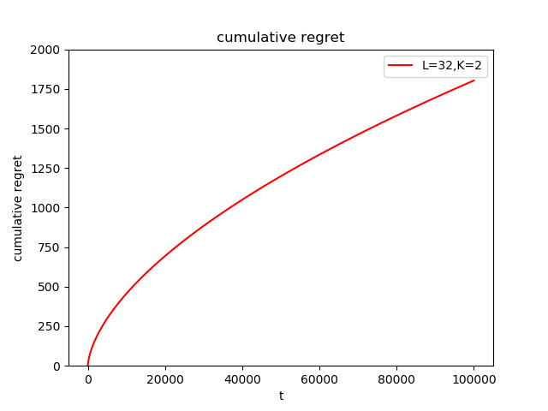
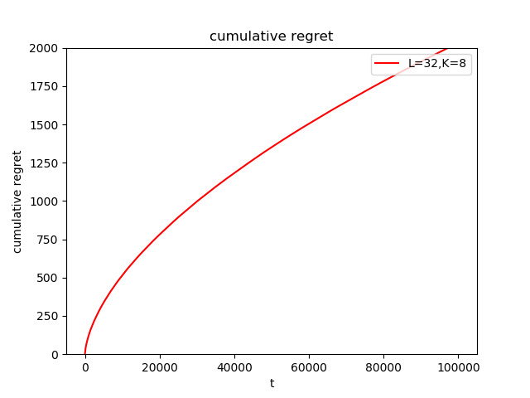
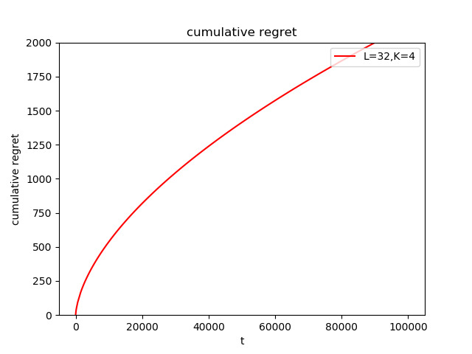
Results of CascadeUCB1
The following are the regret plots for variation of L, k and delta

Slide 45
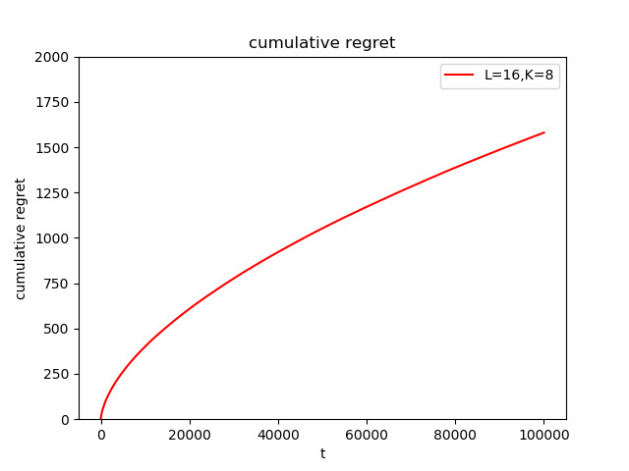
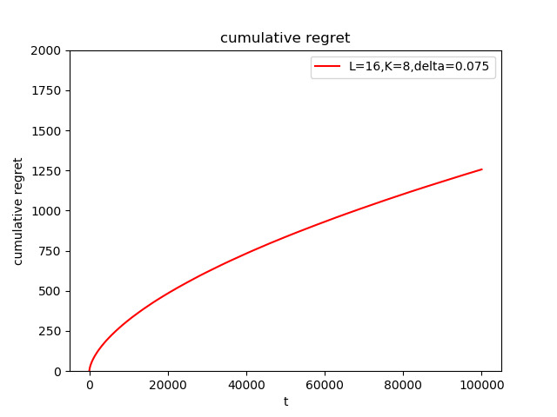
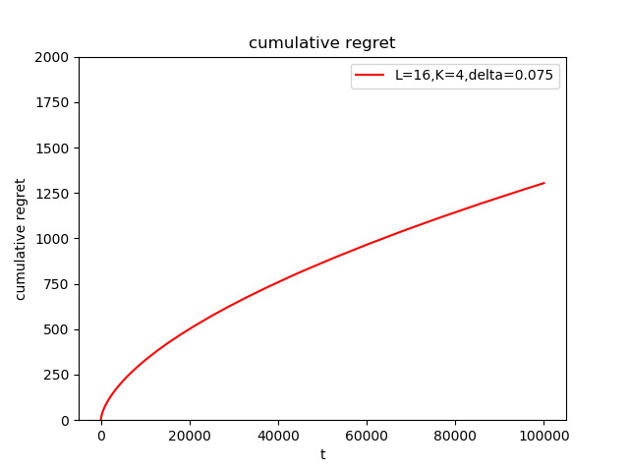
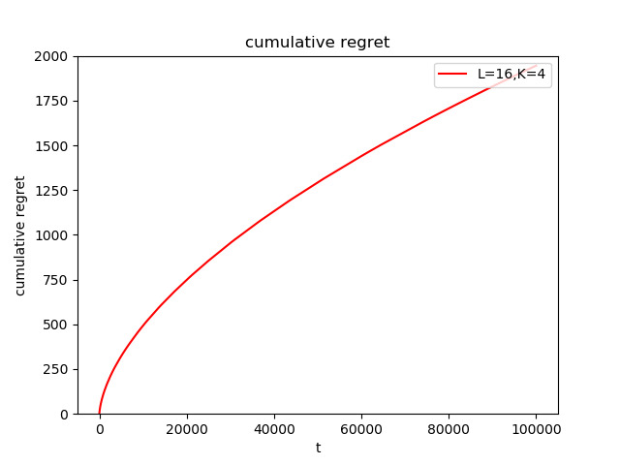



Slide 46
Conclusion
We want to generalize our results to more complex problems, such as learning routing paths in computer networks where the connections fail with unknown probabilities.
From the theoretical point of view, we would like to close the gap between our upper and lower bounds. In addition, we want to derive gap-free bounds.
Finally, we would like to refine our analysis so that it explains that the reverse ordering of recommended items yields smaller regret.

Slide 47
Contribution
Divyansh Ahuja - Studied and implemented the 1)Contextual Combinatorial Cascading Bandits paper 2)Thompson Sampling for Cascading Bandits paper, and analysed their regrets and compared the regrets on tweaking the parameters of the algorithm
Sumrit Gupta - Studied and implemented the 1) Combinatorial Cascading Bandits paper (nips 2015) 2) Cost-aware Cascading Bandits paper, and compared the regrets for different parameter settings for both the papers.
Naman Narang - A) Thorough understanding of a research paper titled “Cascading Bandits: Learning to Rank in the Cascade Model” B) Two different and complete implementations of two algorithms in this paper 1) CascadeUCB12) CascadeKL-UCB C) Complete comparison of both the algorithms using the regret values

